Slide 1


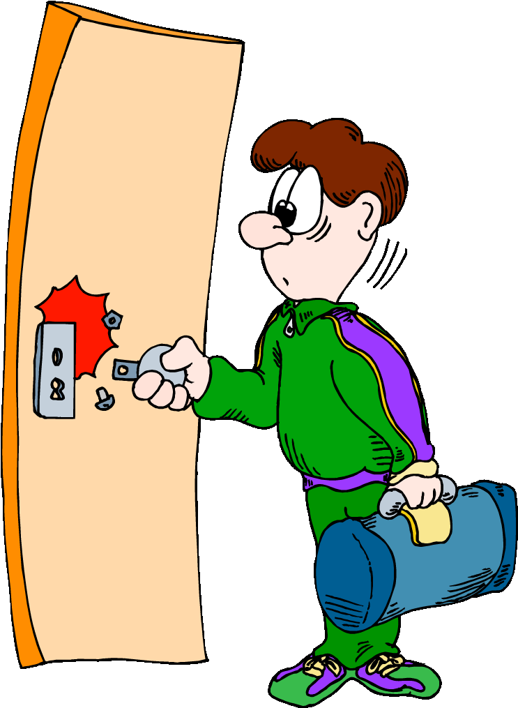
Smart Door Lock System
Guide By
Dr. Amisha Shingala

Slide 2
PROJECT MEMBERS
23mca034
Harveerdan Gadhavi
23mca036
Kishan Gajera
23mca039
Ujjval Gandhi

Slide 3
Proposed System
Defination:
Though the rate of success is less in terms of functionalities and people are still in hope that there will be door lock with all functionalities in a single lock. In our door lock, we simply tried to control it with Wifi via device (Cell Phone).

Slide 4
COUNTINUE…
Objective:
The aim is to develop a secure IoT-based smart door lock system using RFID, fingerprint recognition, and a Flutter app with MQTT for remote access. The system ensures enhanced security through multi-factor authentication, real-time monitoring, and remote control. It provides a user-friendly interface for managing access permissions and tracking activity logs. The design emphasizes scalability, low power consumption, and secure data handling for reliable performance.

Slide 5
COUNTINUE…
Scope:
To be frank with the scope of our system, it is a door lock that has a functionality that is, it can be connected with Wifi and easily controlled. This project can help in several unique way and dealing several day-to-day tasks.

Slide 6
Technologies used
FRONT END: Flutter, Embedded C
BACK END: Dart, MQTT
TOOLS USED: Arduino IDE, Android Studio​
DATABASE: Firebase

Slide 7

FRONT END: FLUTTER
Flutter is a mobile app development platform created by Google .
It is used to develop cross-platform applications for Android, iOS, Linux, macOS, Windows, and the web from a single codebase .
One of the benefits of using Flutter is that you can modify or customize widgets with ease.

Slide 8

BACK END: DART , FIREBASE
Dart is an open-source, client-optimized programming language developed by Google, primarily used with Flutter for building cross-platform apps. It supports both ahead-of-time (AOT) and just-in-time (JIT) compilation for high performance and quick development cycles. With a syntax similar to Java and JavaScript, Dart is easy to learn and features null safety for reliable code. It includes robust libraries and tools for UI, networking, and file handling. Dart is versatile, running on web browsers, mobile devices, and command-line interfaces.

Slide 9
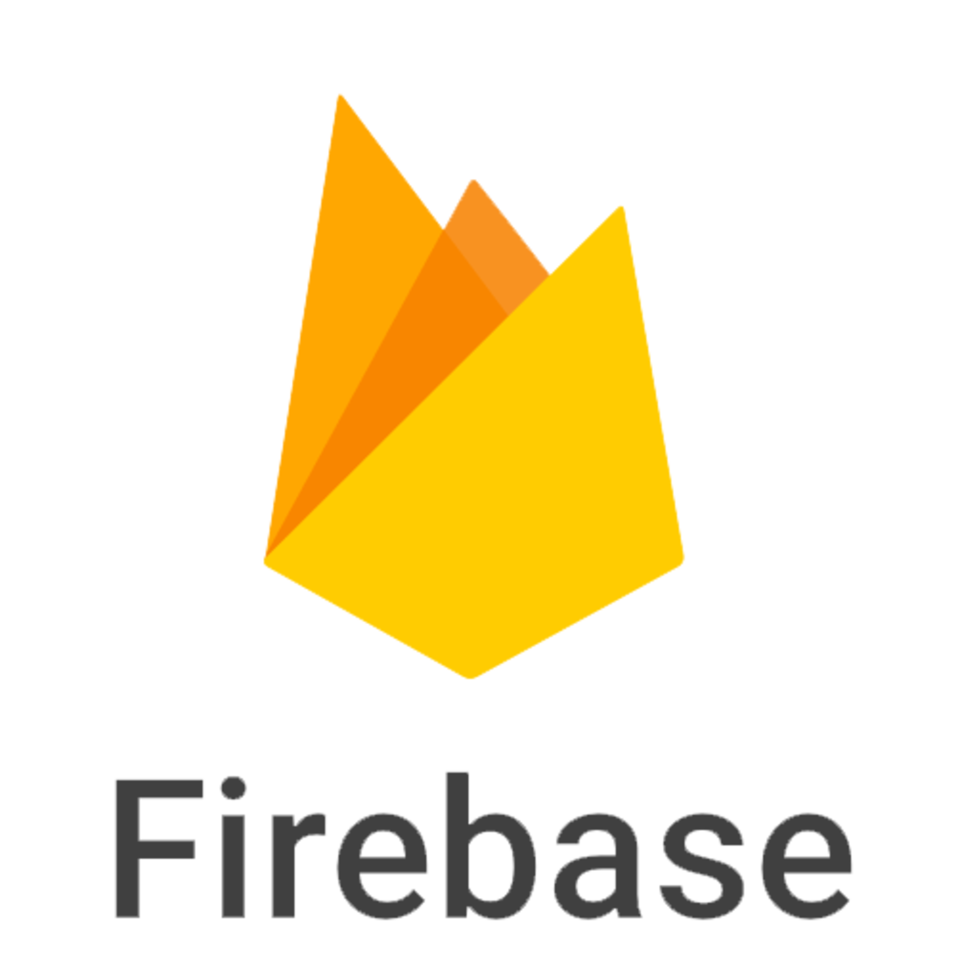
FIREBASE
Firebase is a backend-as-a-service platform by Google that provides tools for building and managing web and mobile apps. It includes real-time databases (Realtime Database and Firestore), authentication services, and cloud storage. Firebase simplifies app development with cross-platform support and integration with tools like Flutter. It ensures data synchronization in real time, even offline, and offers robust security through customizable rules. Its scalability and ease of use make it ideal for modern applications.

Slide 10

MQTT
MQTT (Message Queuing Telemetry Transport) is a lightweight messaging protocol designed for IoT applications and low-bandwidth networks. It uses a publish-subscribe model where devices communicate through a central broker, enabling efficient and decoupled communication. MQTT supports three Quality of Service (QoS) levels, ensuring reliable message delivery. Its lightweight design minimizes resource usage, making it ideal for microcontrollers and real-time IoT devices. Security is ensured with TLS/SSL encryption and authentication mechanisms.

Slide 11
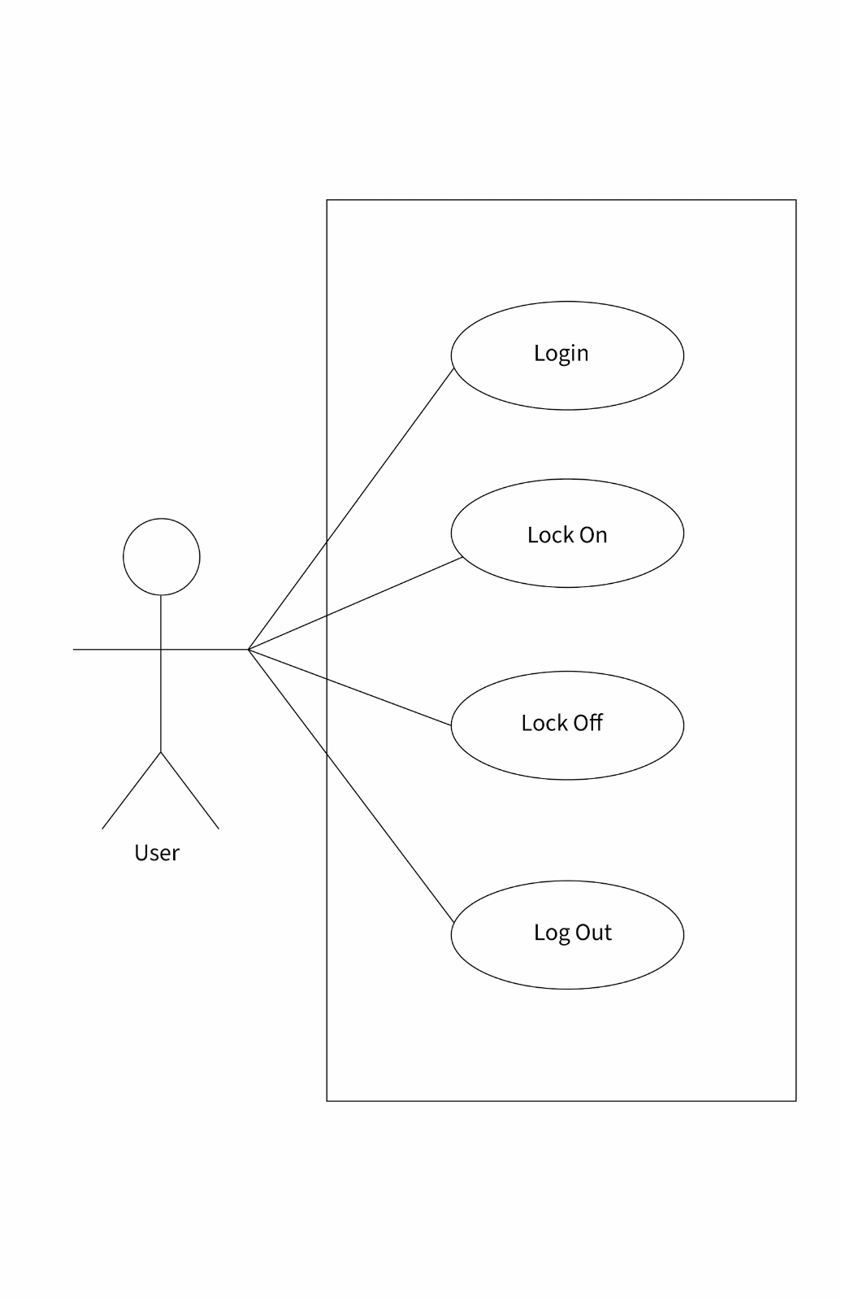
Use-case

Slide 12
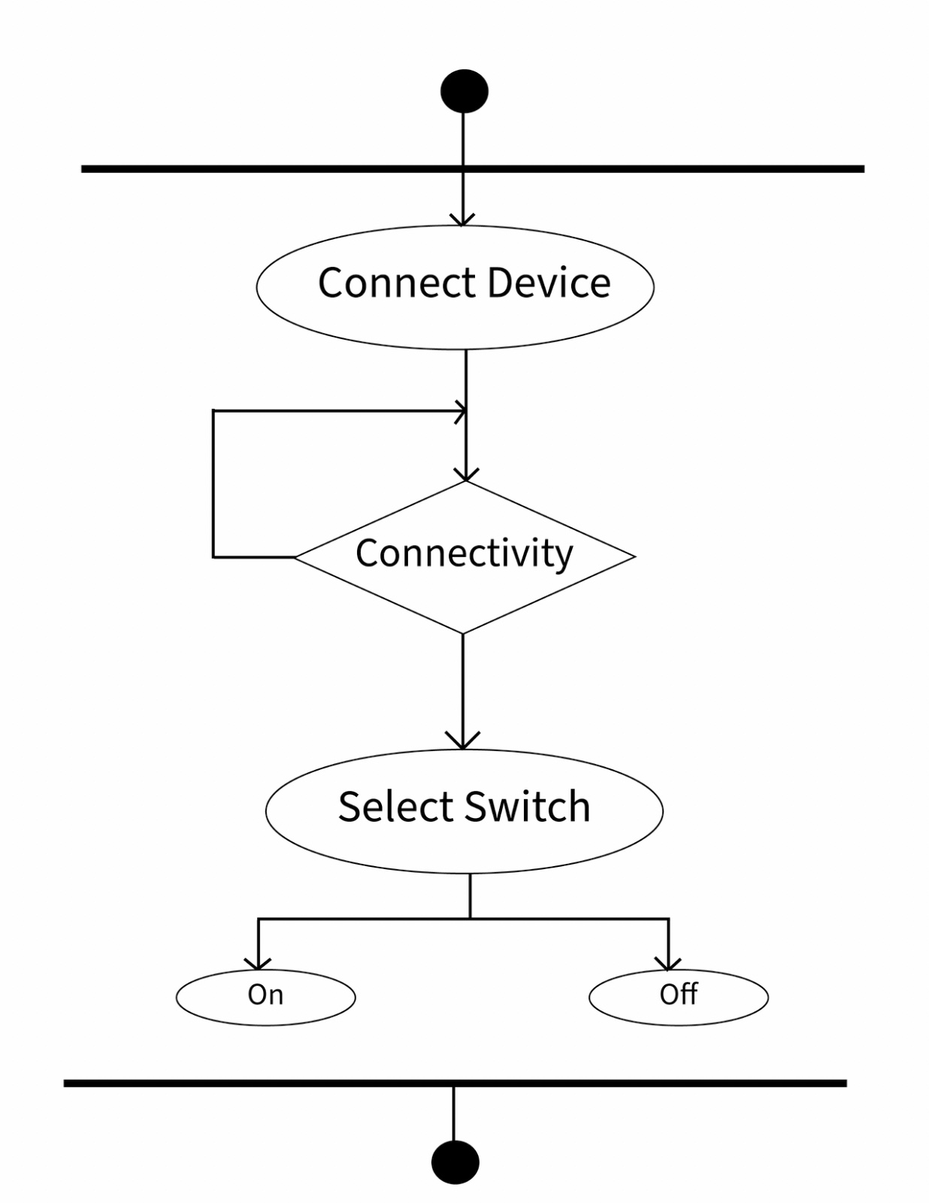
Activity Diagram

Slide 13
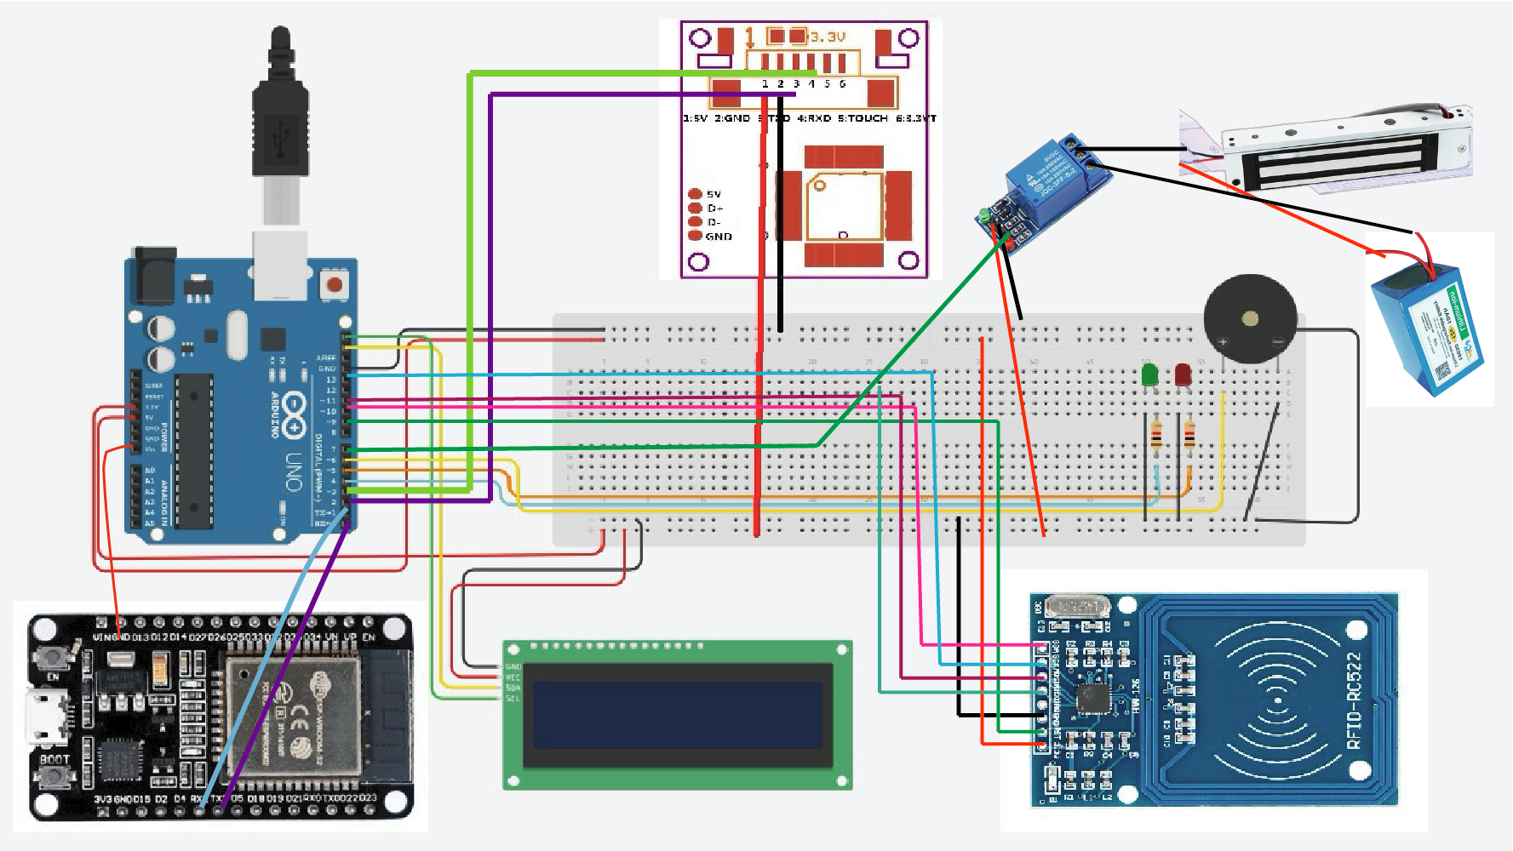
Circuit Diagram

Slide 14
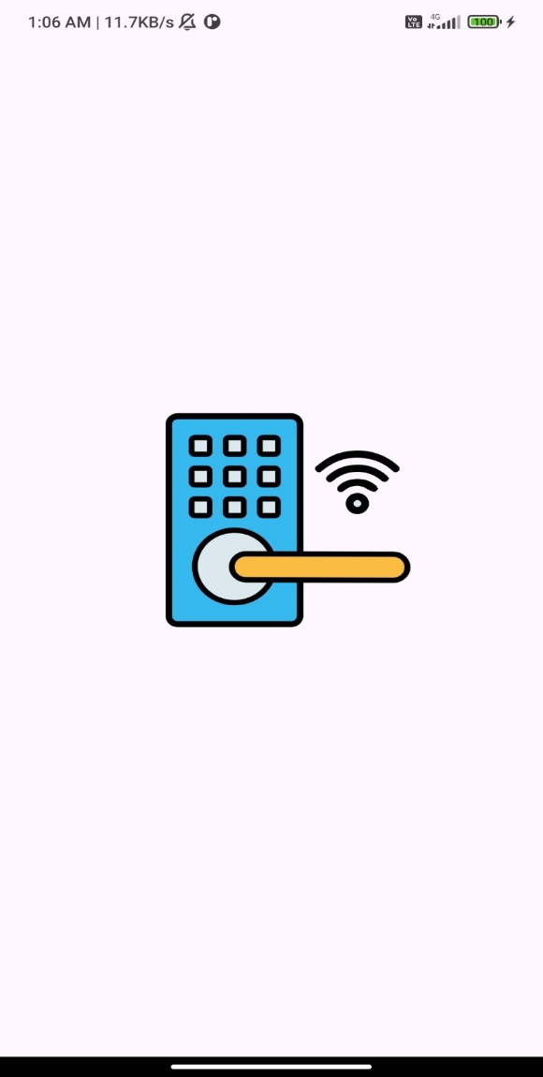
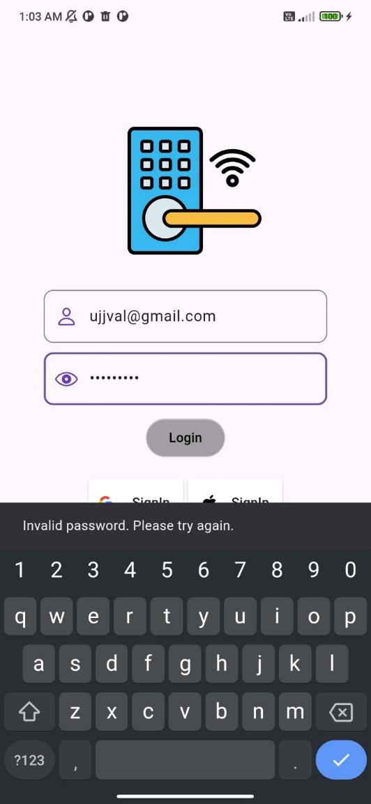
Screen Layouts / Screenshots

Slide 15
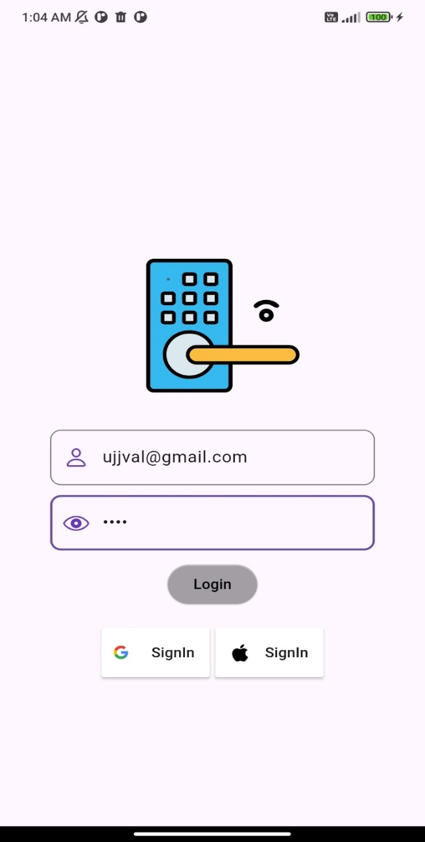
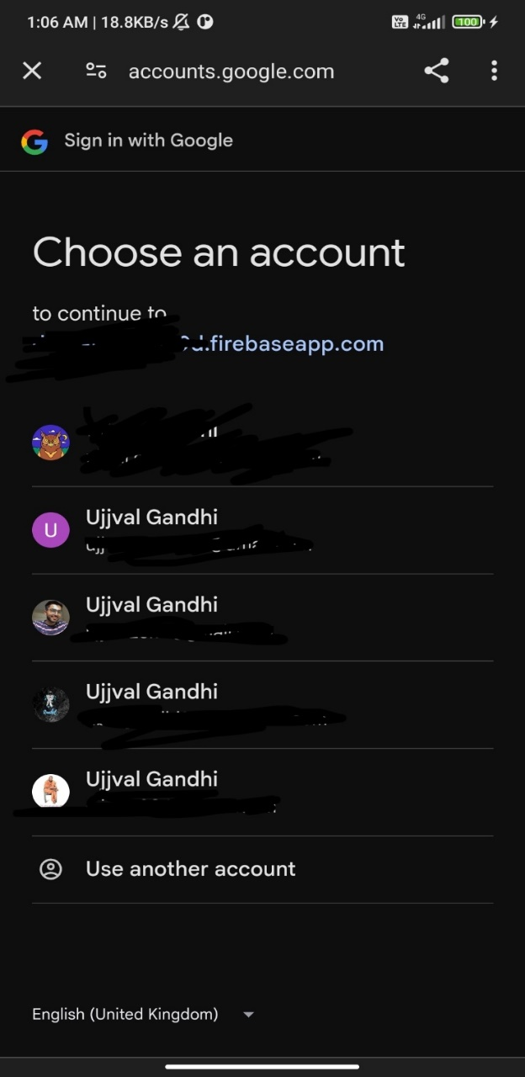
COUNTINUE...

Slide 16
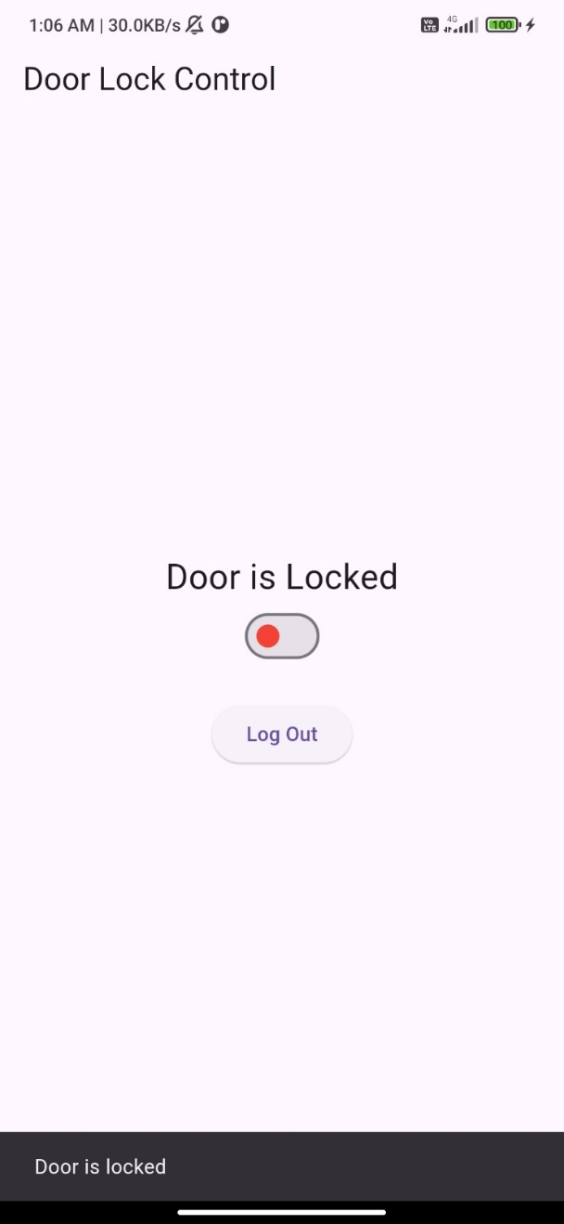
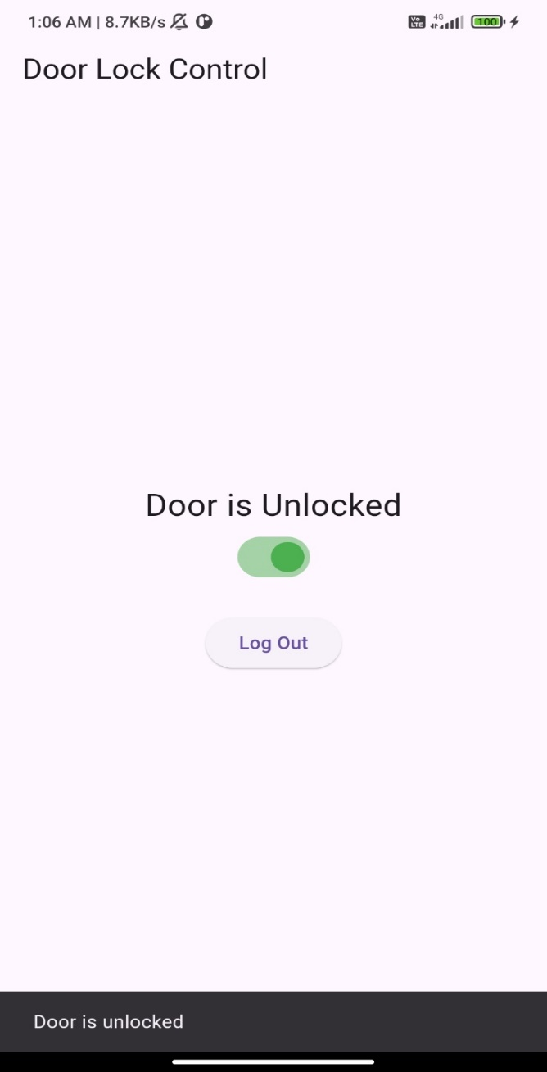
COUNTINUE...

Slide 17
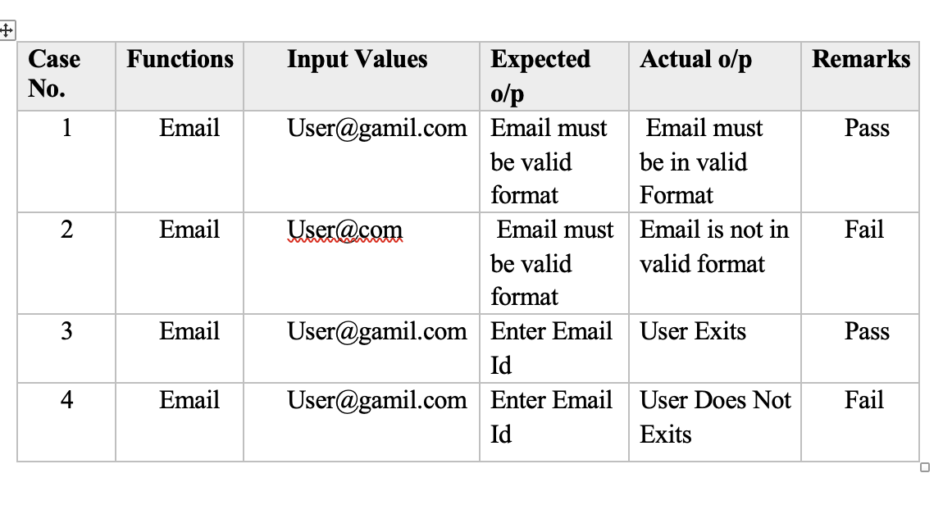
Test Cases
Add User:

Slide 18
Future Enhancement
Integrate voice assistant compatibility (e.g., Alexa, Google Assistant) for hands-free control.
Add facial recognition as an advanced authentication method.
Implement geofencing for automatic locking/unlocking based on user location.
Enable temporary access codes for guest or time-limited access.
Include tamper alerts to notify users of unauthorized attempts.
Provide cloud-based logs for real-time monitoring and access history.
Ensure compatibility with smart home systems for seamless integration.
Optimize energy efficiency for improved battery life and sustainability.

Slide 19
Referance
https://randomnerdtutorials.com/
https://pub.dev/
https://testclient-cloud.mqtt.cool/
https://www.tinkercad.com/
https://www.youtube.com/
https://console.firebase.google.com/

Slide 20
Thank You

